Slide 1
EXPERIMENTS

Slide 2
Basic Principles of Experimentation
Randomization
Replication
Blocking
Current (A)
10 A
12 A
15 A
Torque (N m)
 | I | II | III
10 12 15 | 500 550 | 510 540 | 485 560

Slide 3
Purpose
Factors (or Input or Design or Control Variables)
Response Variable
Design – RCBD, Factorial Design, RSM

Slide 4
Details of an Experiment
- Experimental setup
- Specifications of machines, materials, and instruments
- Response variables, Control variables, Nuisance variables
- Factor levels
- Type of design and the reason for its choice
- Blocking and replicates
- Procedure of conducting the experiments.
- Safety procedures
- Ethical considerations
- Duration
- Any special features

Slide 5
Materials
Give technical specifications, quantities, and source (or the method of preparation).
Give brand name and manufacture (and even distributor’s name) if the material is a non-standard one, not readily available in the market.
In case of specially procured or proprietary materials, give the pertinent physical and chemical properties (rather than the trade name).
If subjects are used, give the total number of subjects, how they were selected, details of sex, age, profession, etc.

Slide 6
Methods
Cite reference for your methods.
If techniques are widely familiar, use only their names, and give references, if necessary.
Any modification to technique should be explained, unless the modification is trivial.
Give details of unusual experimental designs or statistical methods.

Slide 7
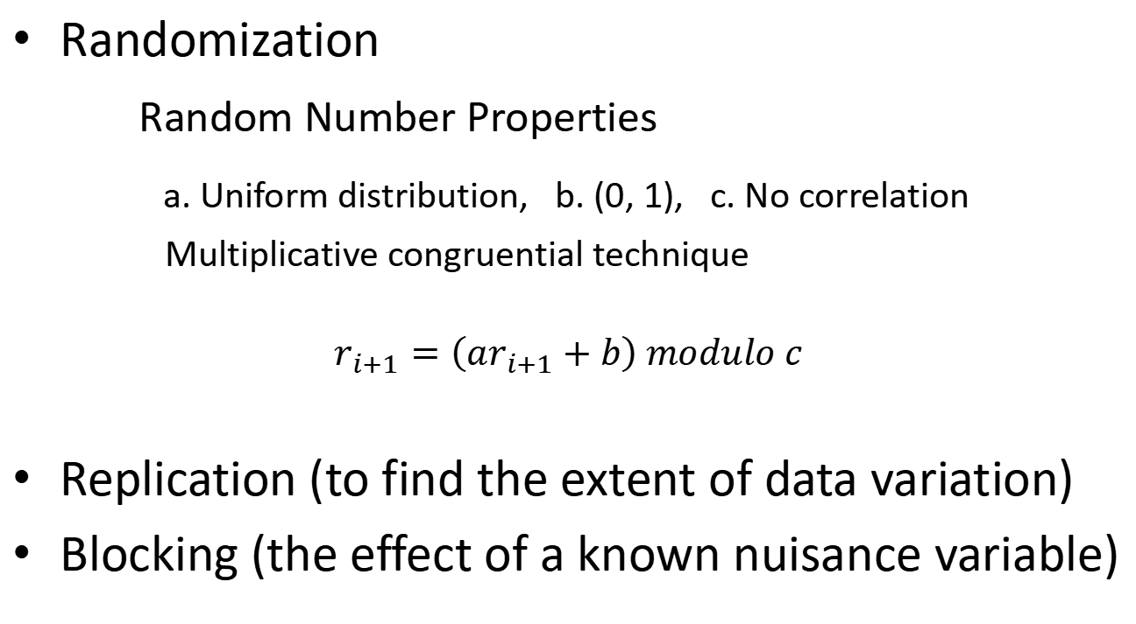
Basic Principles of Experimentation
Randomization
Random Number Properties
a. Uniform distribution, b. (0, 1), c. No correlation
Multiplicative congruential technique
$$r_{i+1}=\left(ar_{i+1}+b\right) modulo c$$
Replication (to find the extent of data variation)
Blocking (the effect of a known nuisance variable)

Slide 8
Analysis of Results
The most popular forms of data analysis are:
- Graphical presentation
- Tabular presentation
- Descriptive statistical analysis of the data
- Tests of hypotheses
- Analysis of variance
- Response Surface Methodology
- Regression analysis

Slide 9
Tensile Strength, kg/cm²
30
20
10
0
10
15
20
25
30
35
40
Graphical Presentation
Cotton Weight Percentage
Box Plots of Tensile Strength Versus Cotton Weight Percentage
Tensile Strength, kg/cm²
30
20
10
0
10
15
20
25
30
35
40
Cotton Weight Percentage
Scatter Diagram of Tensile Strength Versus Cotton Weight Percentage

Slide 10
Joining adjacent data points is not correct.
50
40
30
20
10
●
●
●
Mean Value of MRR (g/s)
●
●
●
●
●
10 15 20 25 30 35 40 45
Speed (m/s)
Mean Material Removal Rate vs. Speed

Slide 11
50
40
30
20
10
●
●
●
●
Mean and Its 95 % C.I.
Mean Value of MRR (g/s)
●
●
●
●
●
10 15 20 25 30 35 40 45
Speed (m/s)
Mean Material Removal Rate vs. Speed

Slide 12
50
40
30
20
10
●
●
●
Mean Value of MRR (g/s)
●
●
●
●
●
10 15 20 25 30 35 40 45
Speed (m/s)
High-Precision Measurement

Slide 13
Error Bars
Error bars represent one standard deviation, one standard error, or 95% confidence interval.
So it must be stated clearly.

Slide 14
Writing Guidelines
Use passive voice to present this section.
Do not switch between active voice and passive too often.
- We measured the tensile strength. It was measured by using a universal testing machine.
- We measured the tensile strength with the use of a universal testing machine.
Use past tense to report past actions. But use present tense to indicate the listing of criteria in a table, etc.

Slide 15
Ethical Conduct
For human studies and animal studies, one has to follow national and international guidelines (such as Declaration of Helsinki) for conducting experiments on them.

Slide 16
Descriptive Statistical Analysis
Frequency Distribution
Central Tendency: Mean, Mode, and Median
Dispersion around the Central Tendency:
Standard Deviation and Range
Skewness
Kurtosis
Note:
For small sample size and for categorical variables, median is better.
Standard deviation = √ {[1/(n – 1)]∑(x_{i} –x_{avg})²}

Slide 17
Test of Hypothesis
Equality of Means or Equality of Variances is common.
Mention the null and the alternative hypotheses:
Note the subscript zero (not the letter “o”) for the null hypothesis.

Slide 18
Mention the test statistic used (z, t, χ², F) along with degrees of freedom (if appropriate).
Decision could be:
Reject H₀
Cannot reject H₀
Accept H₁
Cannot accept H₁
Never say “Accept H₀”
Mention the level of significance and/or the p-value.

Slide 19
ANOVA Table
Single-Factor, Fixed Effects Model
Source of Variation | Sum of Squares | Degrees of Freedom | Mean Square | F₀
Between treatments | SS_{Tr} | a – 1 | MS_{Tr} | MS_{Tr}/MS_{E}
Error (within treatments) | SS_{E} = SS_{T} – SS_{Tr} | N – a | MS_{E}
Total | SS_{T} | N – 1

Slide 20
Regression Analysis
Regression equation
R-square and Adjusted R-square
Significance of the regression parameters
(standard errors or t-statistics of the parameters)
Significance of the model (F-statistic)

Slide 21
Viscosity = 1 566 + 7.62 Temp + 8.58 Feed Rate
Std. Error: (61.6) (0.618) (2.439)
t: (25.43) (12.32) (3.52)
R² = 92.7% Adj. R² = 91.6% F = 82.50
R²: Coefficient of Multiple Determination

Slide 22
Examples
•
•
•
•
•
•
•
R² = 0.9701
•
R² = 0.30
Too less number of points.
Too less number of points.
High dispersion of values.

Slide 23
Explanation of Data and Results
Explanation of data and results is a scientific necessity.
The researcher must give acceptable explanation of the variation of experimental data within and between experiments.
A quantitative explanation requires mathematical and/or statistical modeling.
A qualitative explanation is a logical reasoning of the cause-effect relationships among variables.

Slide 24
Validation of Experimental Results
Internal validation
External validation

Slide 25
Internal Validation
Checks for inconsistency or contradiction in the data and the results.
The presence of inconsistency or contradiction indicates that the experiment had not been carried out in a scientific and well-planned manner.

Slide 26
External validation
Checks for matching of results with those obtained by others.
In case of a mismatch, credible explanation must be given.
If the researcher’s test conditions are different from those of the other researchers, the results may not match, but they should be plausible and explainable.

Slide 27
Interpretation of Experimental Results
Theoretical interpretations bring out the latent relationships among factors and progonosticate the likely effect of changes in factor settings on the figures of merit.
Practical interpretations highlight the possible ways the results can be used in practice to develop new materials, products, or processes, find optimum factor settings, or achieve improvement in the performance in the existing process or product.

Slide 28
Generalization of Experimental Results
Experiments are carried out in a specific experimental setting.
The results should be general enough to be of interest to other researchers in the field.
Setting of the objectives of the experiment, choosing the variables and their settings, using a measurement system with high capability, and analyzing and interpreting the results properly hold the key to generalization.

Slide 29
Significant Digits (or Figures) and Rounding of Numbers

Slide 30
Importance of Significance Digits (Figures)
Suppose the population of a city is 2,534,217.
Considering that this figure can be inaccurate, the student can rightly decide to state an approximate value.
The question is: What should be the approximate value?
Should it be 2,500,000 or 2,534,000, or what?
The concept of significant digits helps to decide this value.

Slide 31
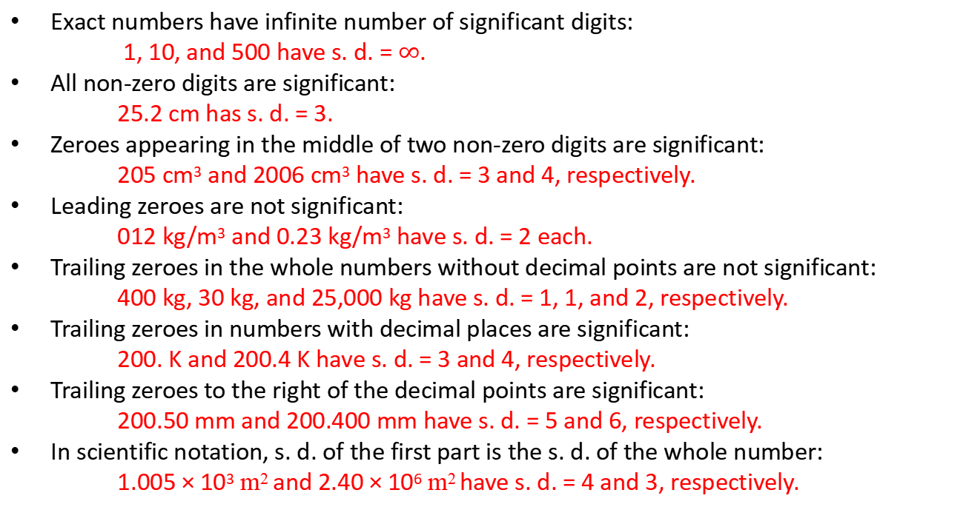
Rules for Significant Digits (s. d.)
Exact numbers have infinite number of significant digits:
1, 10, and 500 have s. d. = $∞$.
All non-zero digits are significant:
25.2 cm has s. d. = 3.
Zeroes appearing in the middle of two non-zero digits are significant:
205 cm³ and 2006 cm³ have s. d. = 3 and 4, respectively.
Leading zeroes are not significant:
012 kg/m³ and 0.23 kg/m³ have s. d. = 2 each.
Trailing zeroes in the whole numbers without decimal points are not significant:
400 kg, 30 kg, and 25,000 kg have s. d. = 1, 1, and 2, respectively.
Trailing zeroes in numbers with decimal places are significant:
200. K and 200.4 K have s. d. = 3 and 4, respectively.
Trailing zeroes to the right of the decimal points are significant:
200.50 mm and 200.400 mm have s. d. = 5 and 6, respectively.
In scientific notation, s. d. of the first part is the s. d. of the whole number:
1.005 × 10³ m² and 2.40 × 10⁶ m² have s. d. = 4 and 3, respectively.

Slide 32
Rounding of Numbers
To round a number, one has to specify the number of significant digits to which a number should be rounded.
Examples
34.50 rounded to two significant digits is 35. (with decimal point).
34.55 rounded to three significant digits is 34.6 (notice .55 rounded up to .6).
345.05 rounded to two significant digits is 350 (no decimal point).
345.05 rounded to three significant digits is 345.
4.05 rounded to two significant digits is 4.1.

Slide 33
Rounding off a Number
If the last digit of a number is less than 5, drop that number.
If the last digit of a number is equal to or more than 5, then add 1 to the previous digit.
Examples:
12.52 rounded off to nearest tenth is 12.5
12.56 rounded off to nearest tenth is 12.6
2250 rounded off to nearest hundred is 2300.
313.5 rounded off to nearest ten is 310.

Slide 34
Rounding of Numerical Results after Addition and Subtraction
The result be rounded so that its precision equals the lowest degree of precision of the constituent numbers involved in these operations.
Examples
40.2 g + 4.576 g = 44.776 g ≈ 44.8 (as the first quantity has the lower precision of 0.1).
50.108 K + 35.21 K = 85.318 K ≈ 85.32 (as 35.21 has the lower precision of 0.01 and 8 > 5).
12.35 m³ – 25.305 m³ = –12.955 m³ ≈ –12.96 m³
(as 12.35 has a lower precision of 0.01 and the last digit of the result equals 5).

Slide 35
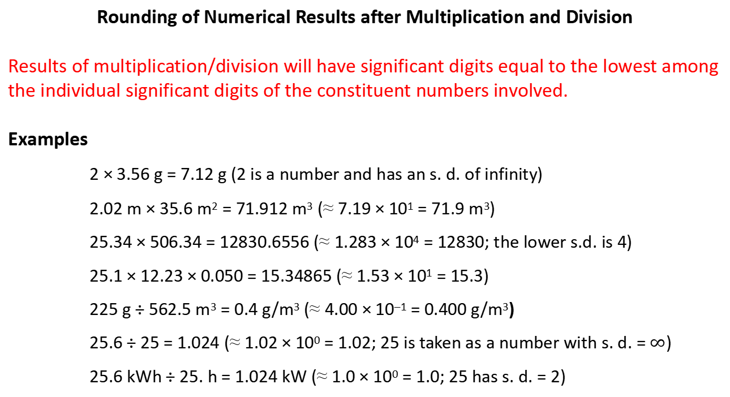
Rounding of Numerical Results after Multiplication and Division
Results of multiplication/division will have significant digits equal to the lowest among the individual significant digits of the constituent numbers involved.
Examples
2 × 3.56 g = 7.12 g (2 is a number and has an s. d. of infinity)
2.02 m × 35.6 m² = 71.912 m³ (≈ 7.19 × 10¹ = 71.9 m³)
25.34 × 506.34 = 12830.6556 (≈ 1.283 × 10⁴ = 12830; the lower s.d. is 4)
25.1 × 12.23 × 0.050 = 15.34865 (≈ 1.53 × 10¹ = 15.3)
225 g ÷ 562.5 m³ = 0.4 g/m³ (≈ 4.00 × 10^{–1} = 0.400 g/m³)
25.6 ÷ 25 = 1.024 (≈ 1.02 × 10⁰ = 1.02; 25 is taken as a number with s. d. = $∞$)
25.6 kWh ÷ 25. h = 1.024 kW (≈ 1.0 × 10⁰ = 1.0; 25 has s. d. = 2)

Slide 36
Rounding of Numerical Results after Mixed Arithmetic Operations
25.0 × 12.23 + 2.530 = 305.75 + 2.530 = 308.280 ≈ 308.
(Rounded to 308.; the significant digits of the result of the multiplication operation equals 3—3rd digit 5 is underlined—and is used to decide the number of significant digits of the result of the arithmetic operation.)
(0.505 – 2.2) ÷ 5 = –1.695 ÷ 5 = –0.339 ≈ –0.34.
(Rounded to –3.4 × 10^{–1} = –0.34; 5 is an exact number with infinite number of significant digits and the quantity within parentheses has significant digits equal to 2; hence 6 is underlined, which is used later to round the final result.)

